Slide 1

WATER VALLEY ISD
NOVEMBER 2019 16 MILLIONBOND ISSUE
THE BACKGROUND
THE ISSUES
THE OPPORTUNITY
THE IMPACT

Slide 2
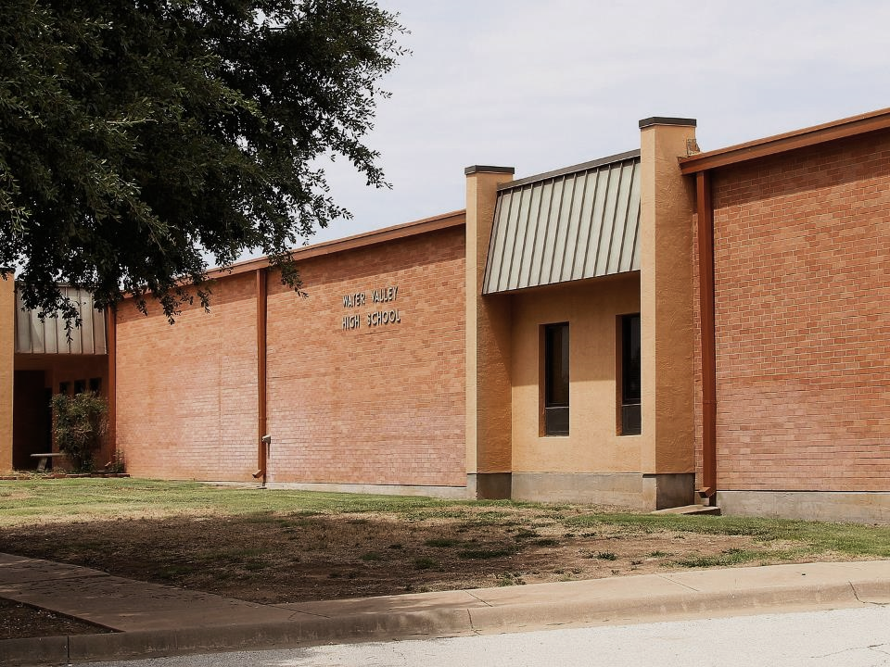
THE BACKGROUND

Slide 3
THE BACKGROUND
WHY THIS BOND ISSUE?
Water Valley ISD in need of replacing outdated and inefficient facilities.
Moreover, it is in need of safe, secure, and reliable facilities that provide a better learning environment for students.

Slide 4
THE BACKGROUND
AN OUTDATED BUILDING…
The Water Valley ISD cafeteria was constructed in 1983
and without the intention of using it as a cafeteria,
NOW 36 YEARS OF AGE
The Water Valley ISD’s Agriculture Building was constructed in 1974,
NOW 45 YEARS OF AGE.

Slide 5
WHAT WILL THIS BOND ISSUE INCLUDE?
THE BACKGROUND
Provide facilities that are more adequately sized and up to date with all TEA standards and technological expectations.
Provide code compliant spaces that offer handicap access and increase life safety, health, and welfare of occupants.
Create a more secure and safe learning environment for students.
Provide better quality facilities to encourage extracurricular activities and career development.
Transportation Needs

Slide 6
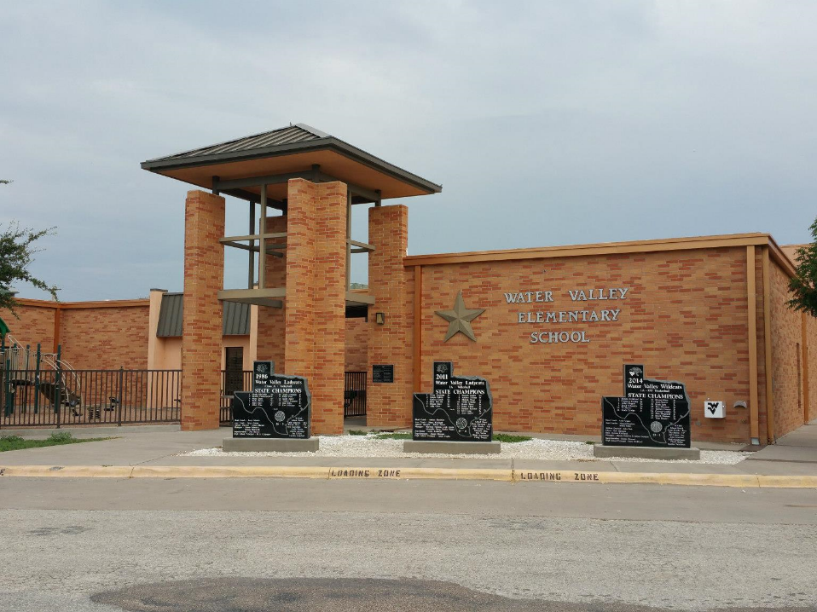
THE ISSUES

Slide 7
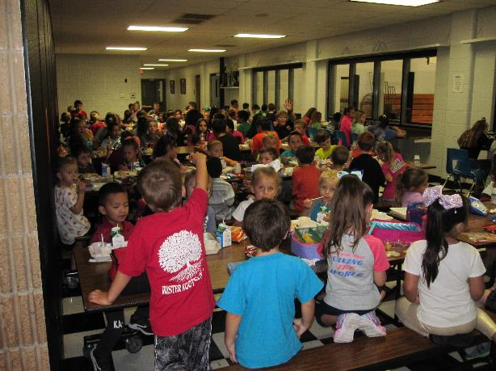
THE ISSUES – THE INTERIOR
Due to school expansion, the facilities are no longer sufficient in providing adequate space for students and faculty.
The cafeteria and serving lines have become overcrowded
and are in need of additional space.

Slide 8
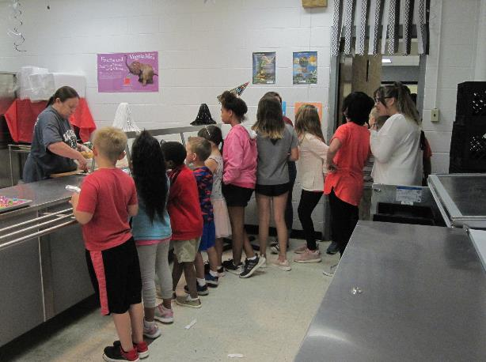
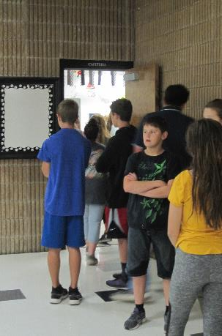
THE ISSUES – THE INTERIOR
The cafeteria and serving lines have become overcrowded
and are in need of additional space.

Slide 9
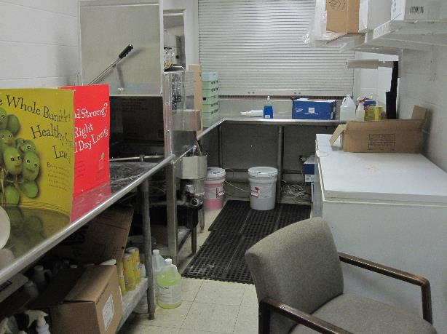
THE ISSUES – THE INTERIOR
Kitchen facilities lack adequate space for staff to operate.

Slide 10
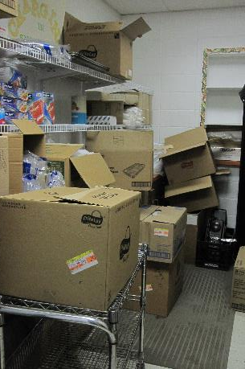
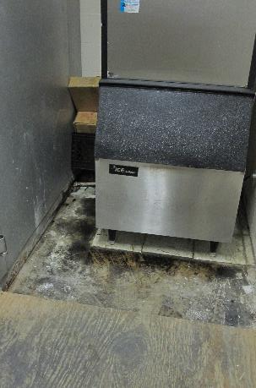
THE ISSUES – THE INTERIOR
Kitchen facilities lack adequate space for staff to operate.
Pantry and storage spaces have also become overcrowded in order to accommodate the student population.
The facilities, despite proper maintenance, have begun to show their age.

Slide 11
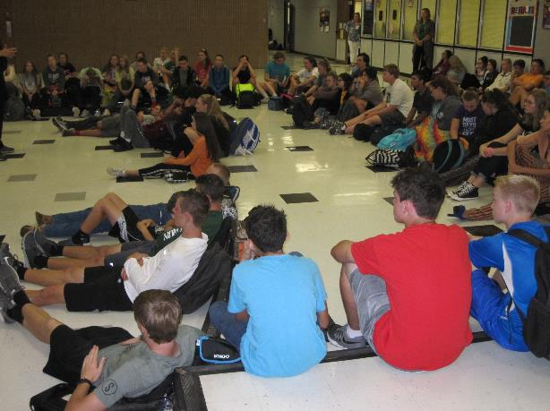
THE ISSUES – THE INTERIOR
There is a need for larger auditorium space to accommodate more people as well as people with disabilities.

Slide 12
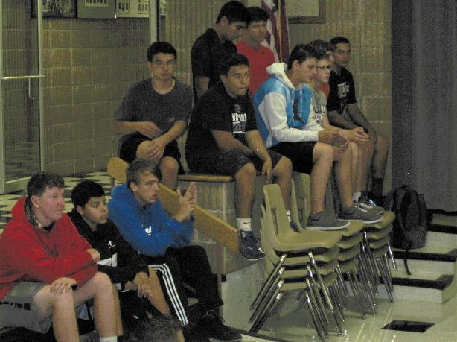
THE ISSUES – THE INTERIOR
There is a need for larger auditorium space to accommodate more people as well as people with disabilities.
The overcrowding of students can be seen throughout.

Slide 13
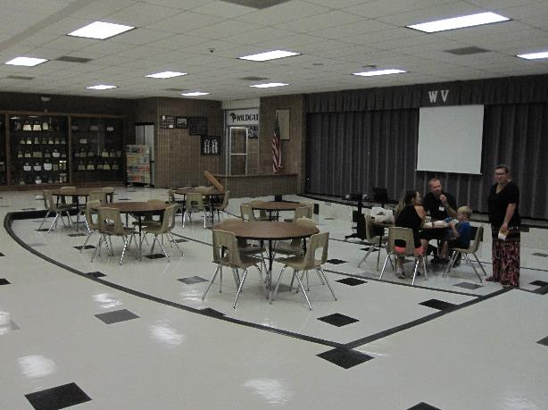
THE ISSUES – THE INTERIOR
The multi-level floor as well as access to the stage is not ADA code compliant.

Slide 14
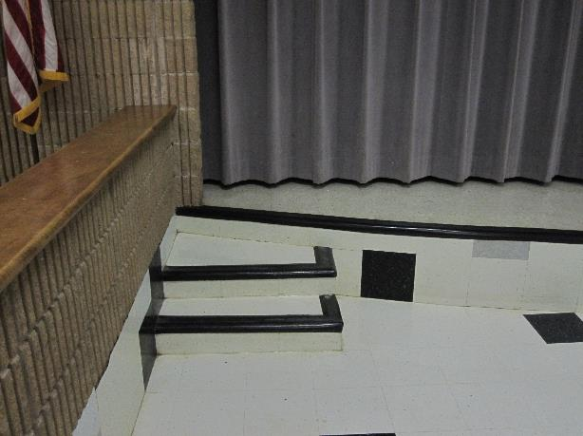
THE ISSUES – THE INTERIOR
The multi-level floor as well as access to the stage is not ADA code compliant.
This prevents equal access from those with disabilities.

Slide 15
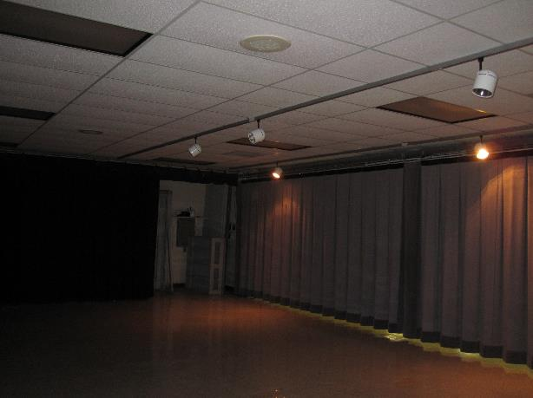
THE ISSUES – THE INTERIOR
Beyond handicap accessibility, the cafeteria stage is outdated in design and spatial capacity.

Slide 16
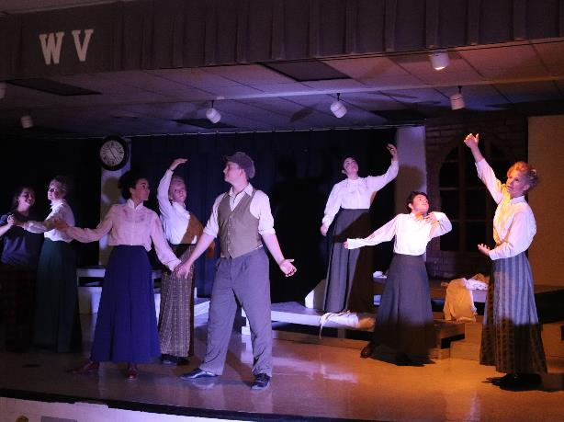
THE ISSUES – THE INTERIOR
Beyond handicap accessibility, the cafeteria stage is outdated in design and spatial capacity.
The stage lacks adequate lighting equipment and technology that meets the needs of both faculty and students.

Slide 17
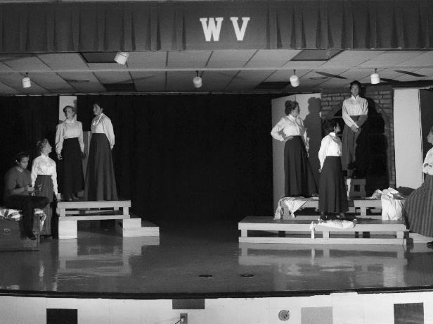
THE ISSUES – THE INTERIOR
Beyond handicap accessibility, the cafeteria stage is outdated in design and spatial capacity.
The stage lacks adequate lighting equipment and technology that meets the needs of both faculty and students.
Current conditions are overcrowded and incapable of accommodating large theater sets and performances.

Slide 18
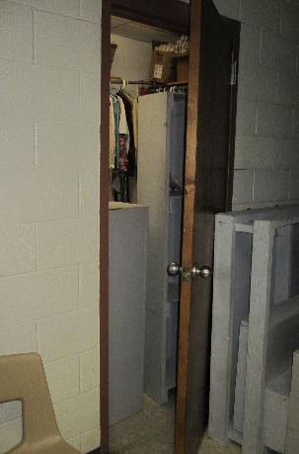
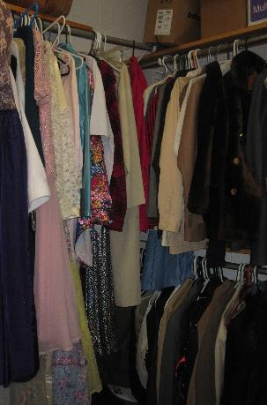
THE ISSUES – THE INTERIOR
The lack of prop and set storage has left hallways cluttered and critical doors blocked causing accessibility issues.
More storage space is much needed.

Slide 19
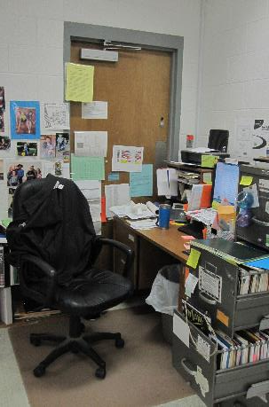
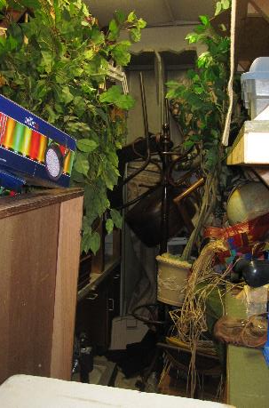
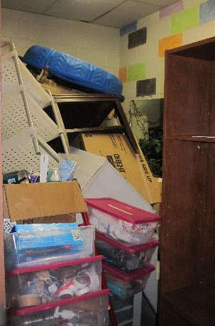
THE ISSUES – THE INTERIOR
Furthermore, the lack of space has forced faculty to create offices in unlikely places.
The school’s population has outgrown its building.

Slide 20
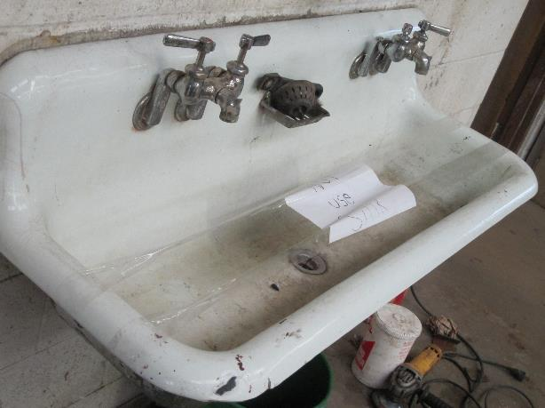
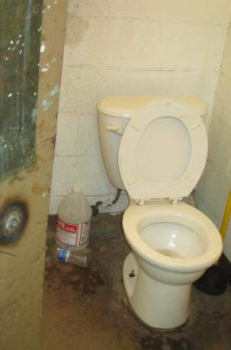
THE ISSUES – THE INTERIOR
In addition, the buildings’ ages are beginning to show through deterioration.

Slide 21
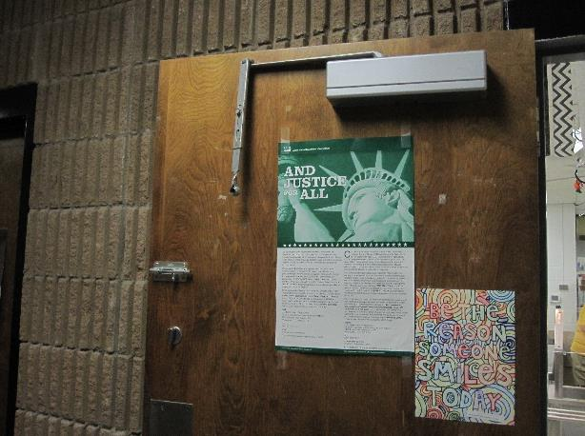
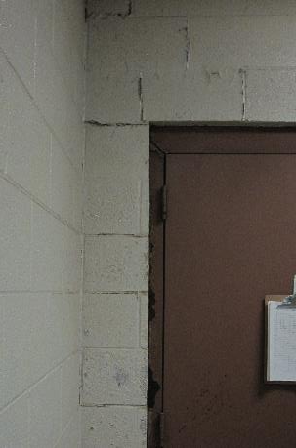
THE ISSUES – THE INTERIOR
In addition, the buildings’ ages are beginning to show through deterioration.

Slide 22
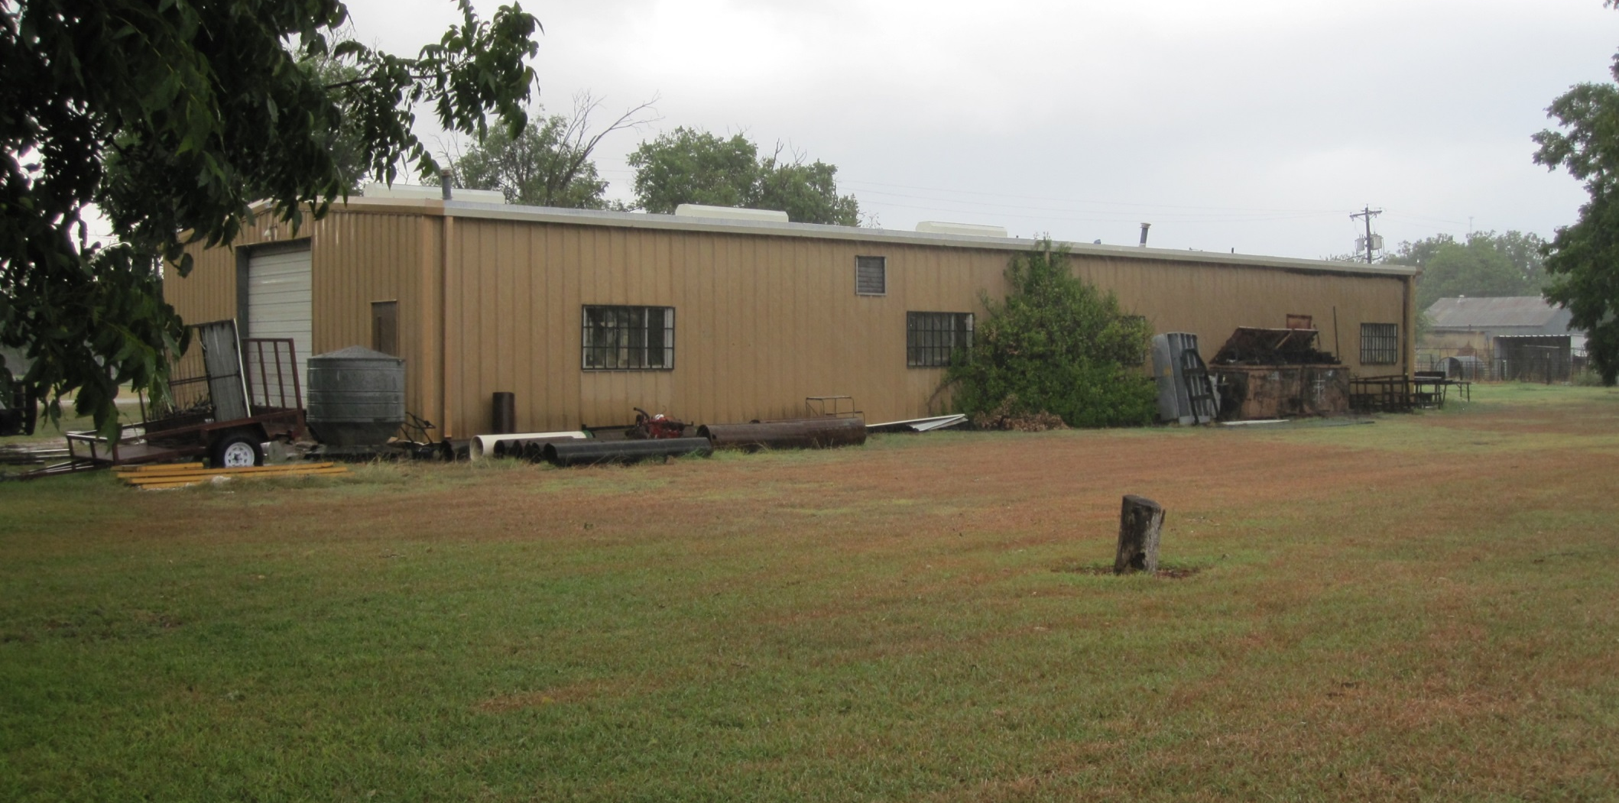
THE ISSUES – THE INTERIOR
The current CTE Building also lacks in sufficient space to accommodate hardware and equipment.

Slide 23
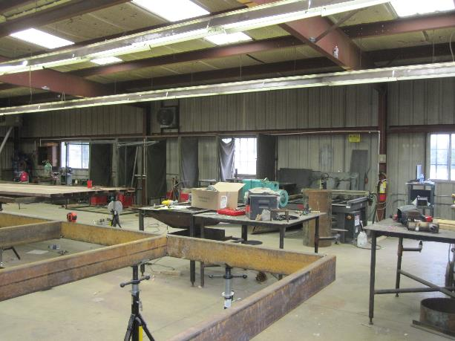
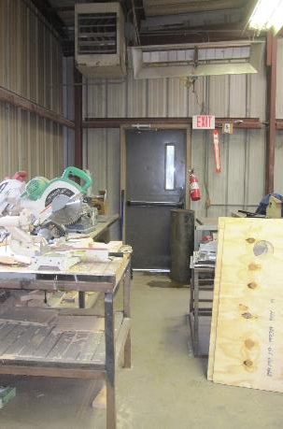
THE ISSUES – THE INTERIOR
The current CTE Building also lacks in sufficient space to accommodate hardware and equipment.

Slide 24
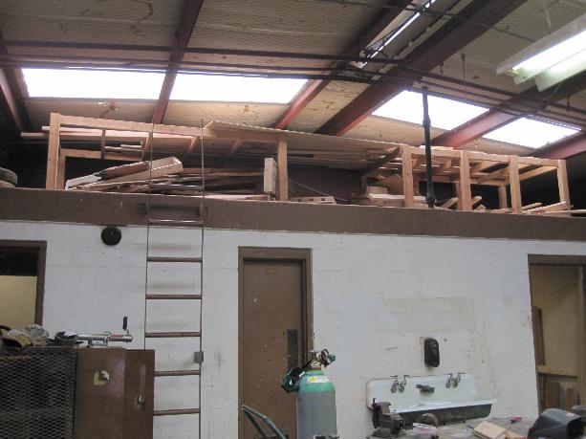
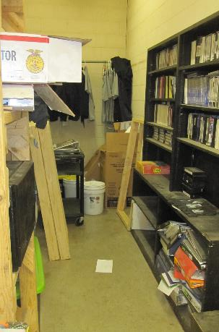
THE ISSUES – THE INTERIOR
The current CTE Building also lacks in sufficient space to accommodate hardware and equipment.
This prevents teachers from creating a proper learning environment for students.

Slide 25
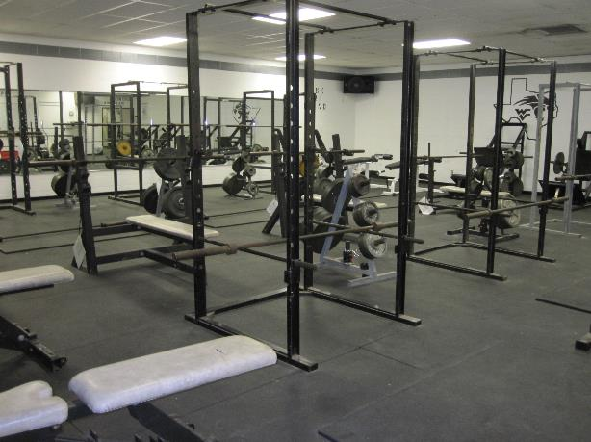
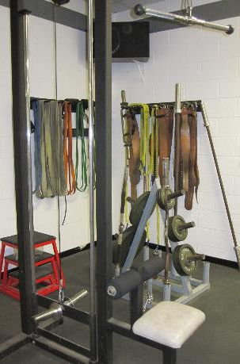
THE ISSUES – THE INTERIOR
The athletic weight room requires large amounts of floor space for lifting to be safe to the students.

Slide 26
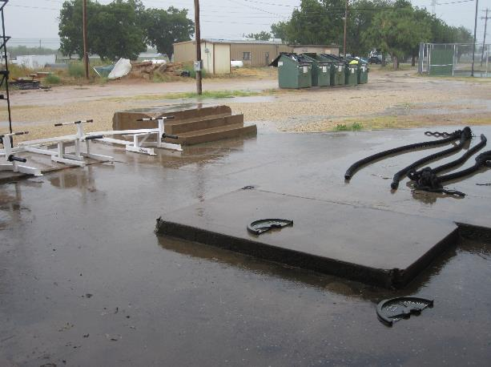
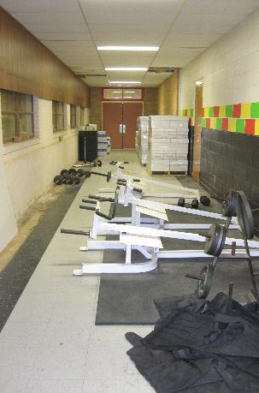
THE ISSUES – THE INTERIOR
The athletic weight room requires large amounts of floor space for lifting to be safe to the students.
This forces the storing of equipment elsewhere such as the corridors and even outside.

Slide 27
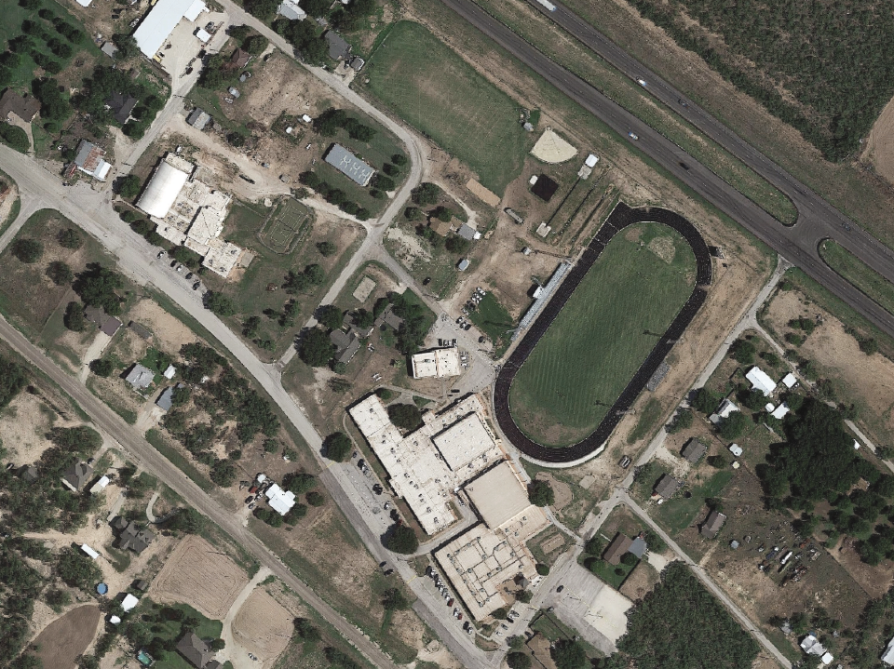
THE OPPORTUNITY

Slide 28
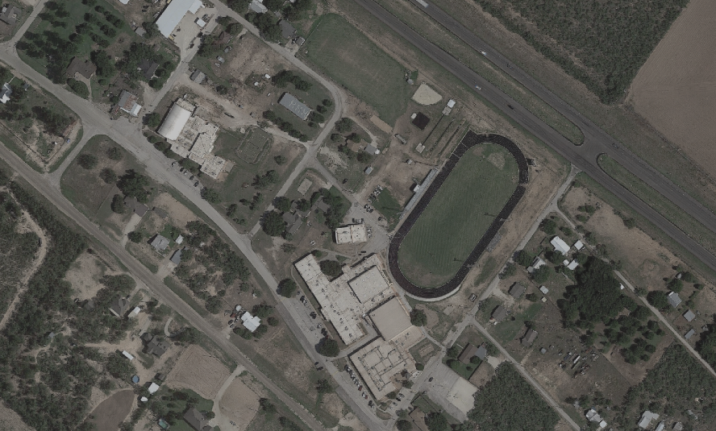
THE OPPORTUNITY
NEW CONSTRUCTION LOCATION
TENNIS
COURTS
PRACTICE &
WEIGHT ROOM
CAREER, TECHNOLOGY,
& EDUCATION FACILITY
REPURPOSED
CLASSROOM SPACE
RESTROOM FACILITY
& PLAYGROUND COVER
CAFETORIUM &
KITCHEN

Slide 29
OTHER IMPROVEMENTS WILL INCLUDE…
THE BACKGROUND
HVAC Upgrades
Plumbing Upgrades
Electrical System Upgrades
Transportation Needs / Buses
Safety and Security Needs
Technology Needs

Slide 30
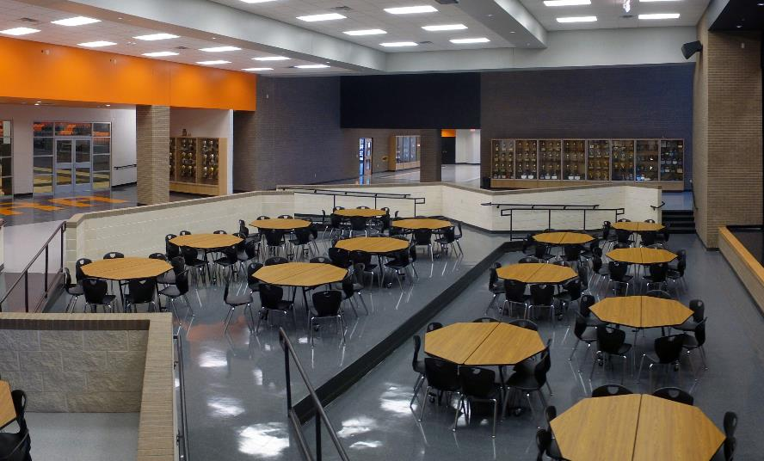
THE OPPORTUNITY
CAFETORIUM & STAGE
IRA I.S.D.

Slide 31
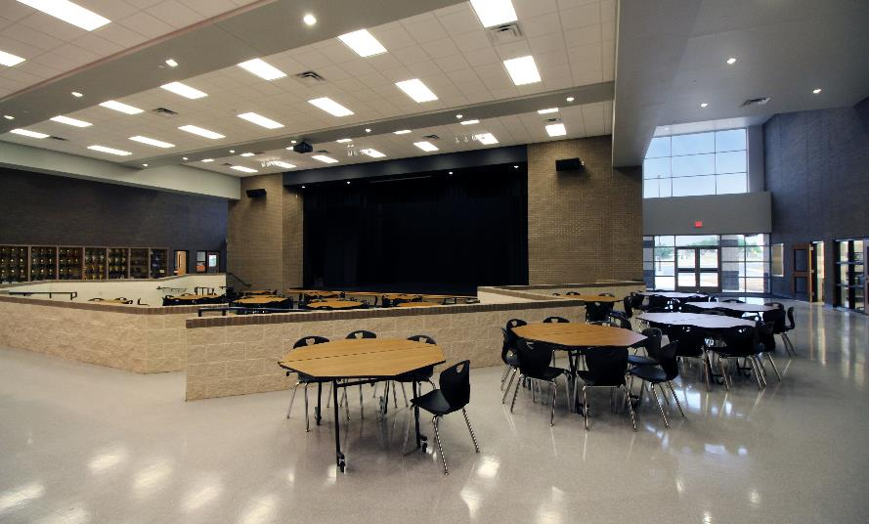
THE OPPORTUNITY
CAFETORIUM & STAGE
IRA I.S.D.

Slide 32
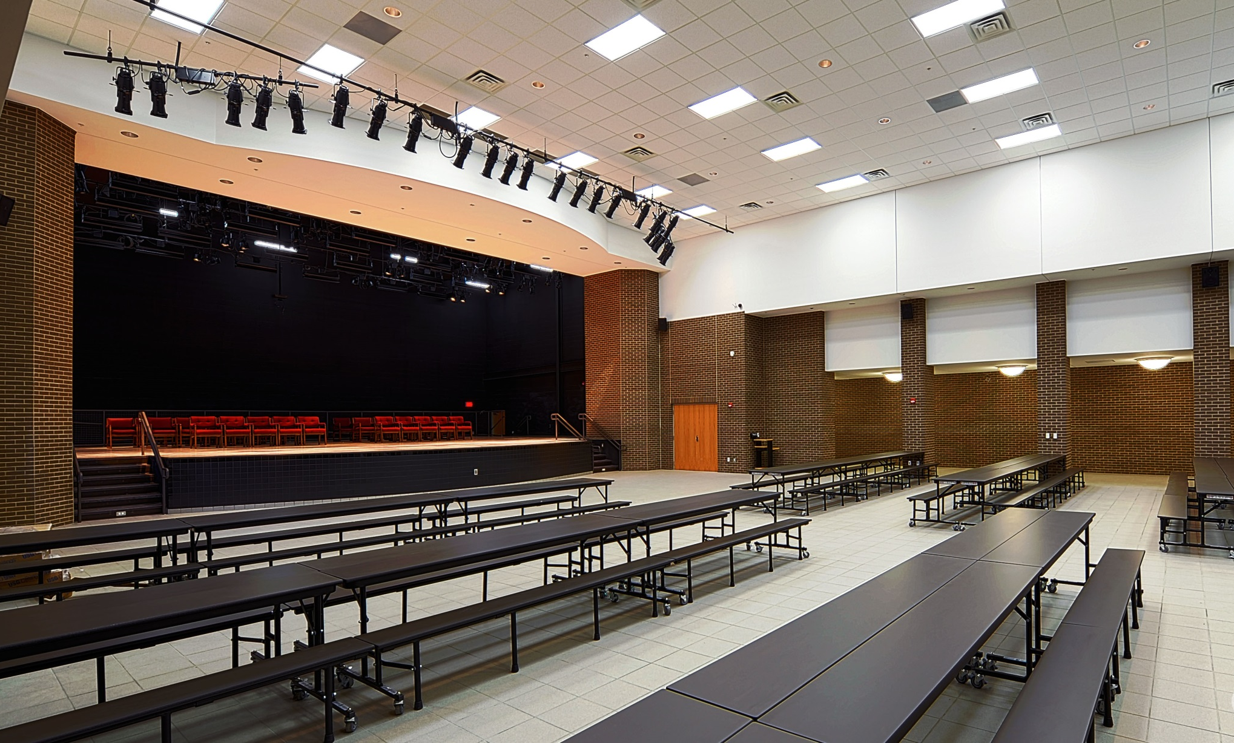
THE OPPORTUNITY
CAFETORIUM & STAGE
DE LEON I.S.D.

Slide 33
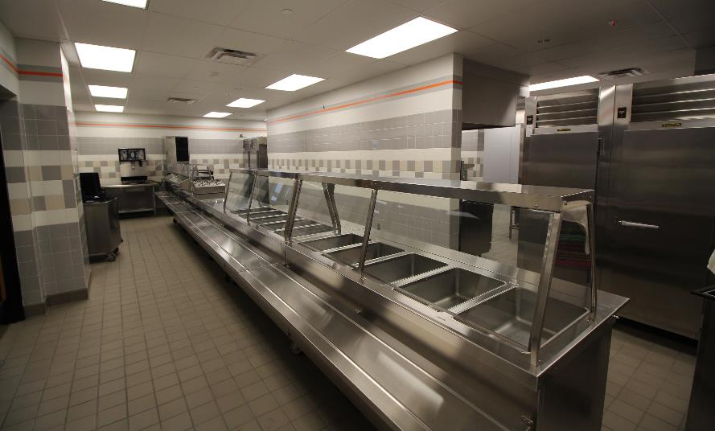
THE OPPORTUNITY
SERVERY
IRA I.S.D.

Slide 34
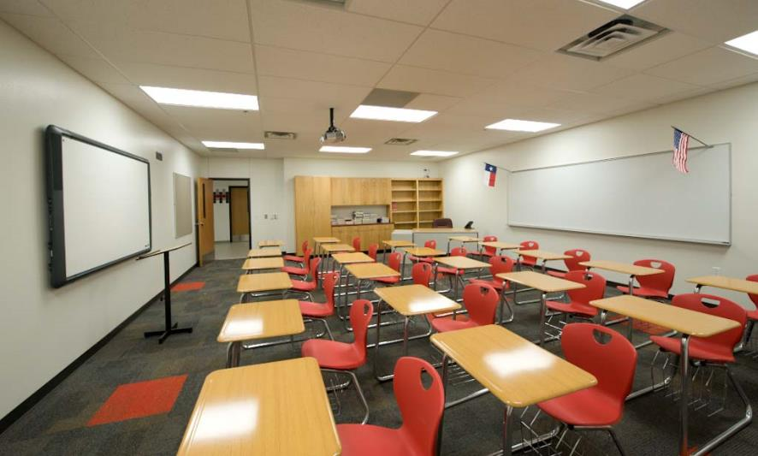
THE OPPORTUNITY
REPURPOSED CLASSROOM SPACE
HERMLEIGH I.S.D.

Slide 35
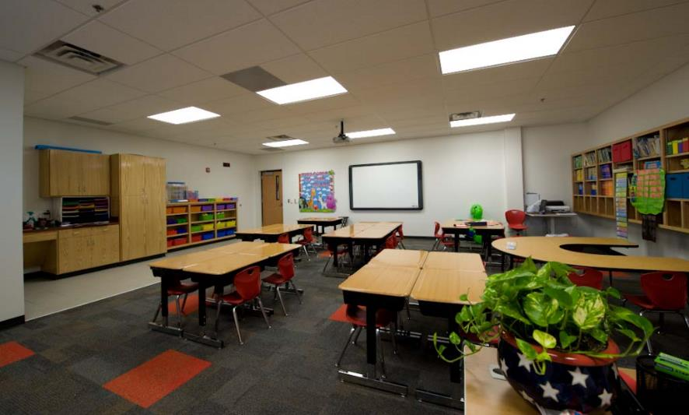
THE OPPORTUNITY
REPURPOSED CLASSROOM SPACE
HERMLEIGH I.S.D.

Slide 36
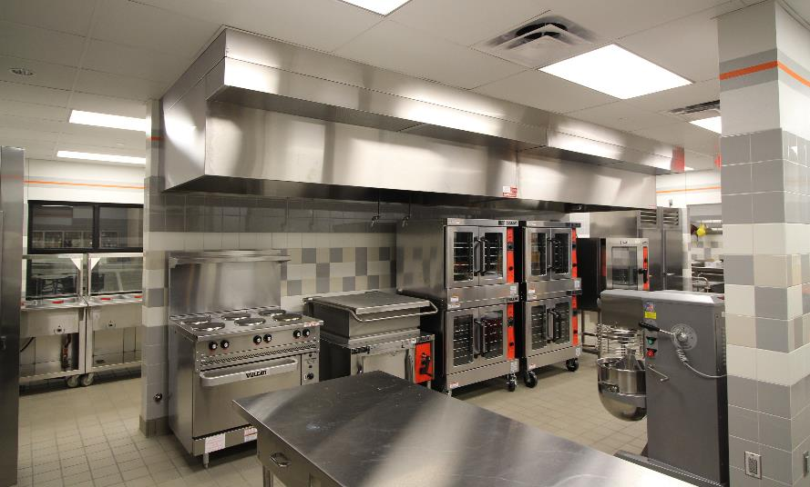
THE OPPORTUNITY
KITCHEN
IRA I.S.D.

Slide 37
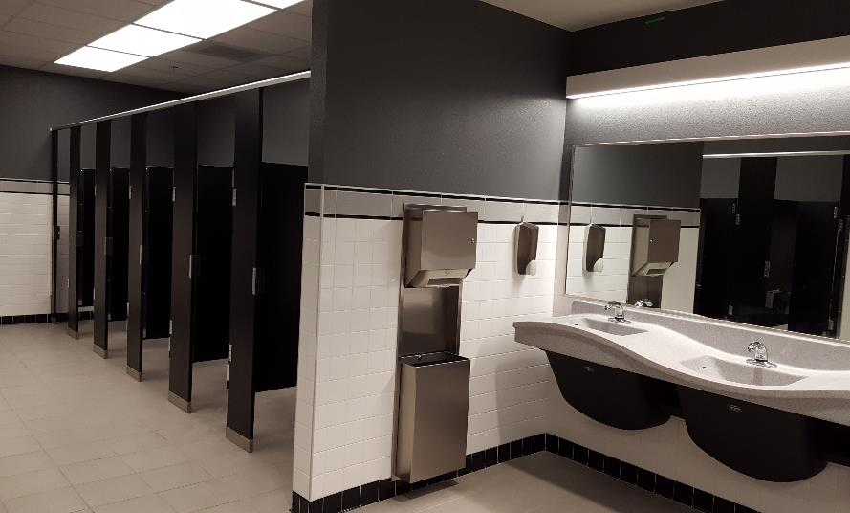
THE OPPORTUNITY
RESTROOM FACILITY
WYLIE I.S.D.

Slide 38
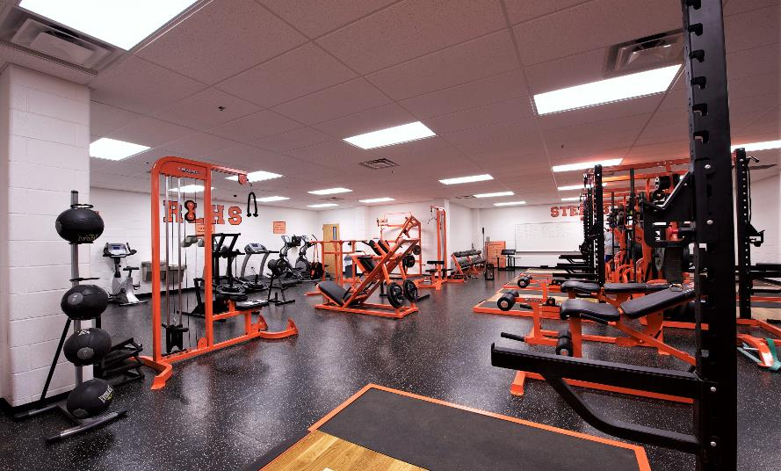
THE OPPORTUNITY
PRACTICE & WEIGHT ROOM
ROBERT LEE I.S.D.

Slide 39
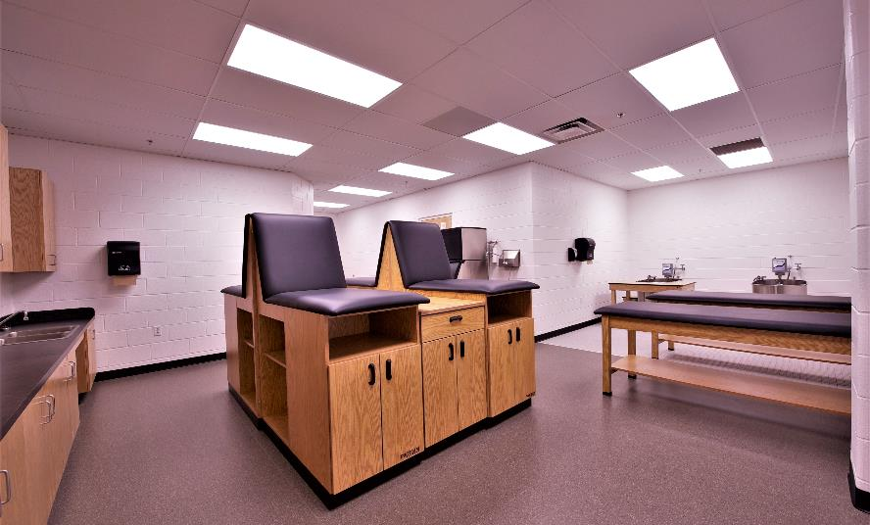
THE OPPORTUNITY
PRACTICE & WEIGHT ROOM
ROBERT LEE I.S.D.

Slide 40
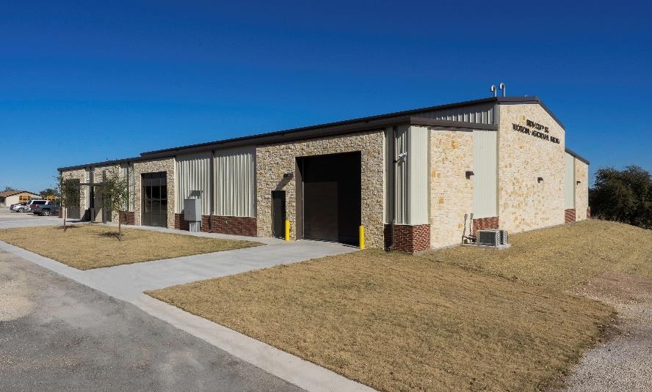
THE OPPORTUNITY
CTE FACILITY
IRION COUNTY I.S.D.

Slide 41
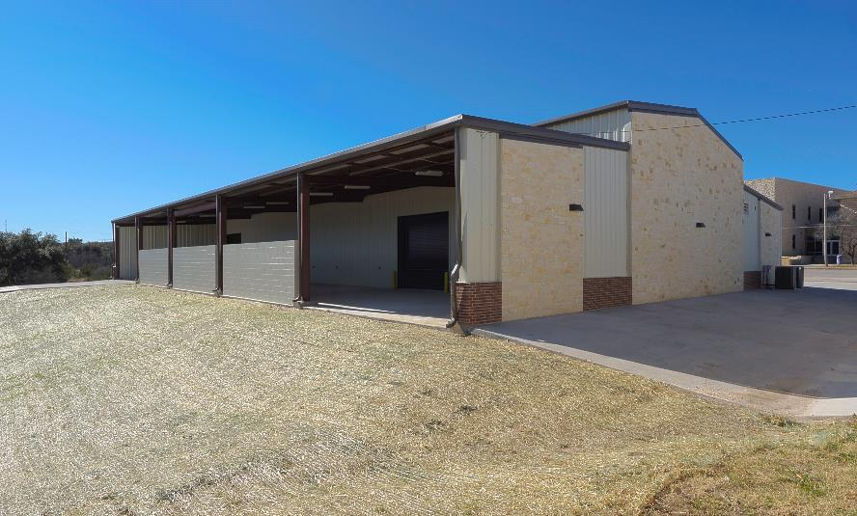
THE OPPORTUNITY
CTE FACILITY
IRION COUNTY I.S.D.

Slide 42
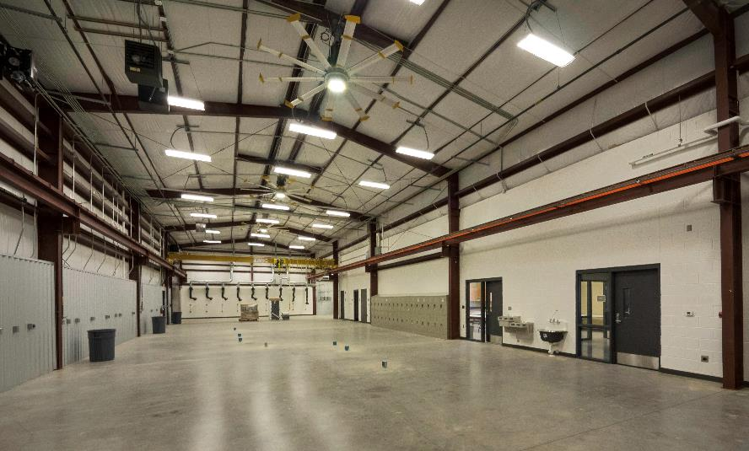
THE OPPORTUNITY
CTE FACILITY
IRION COUNTY I.S.D.

Slide 43
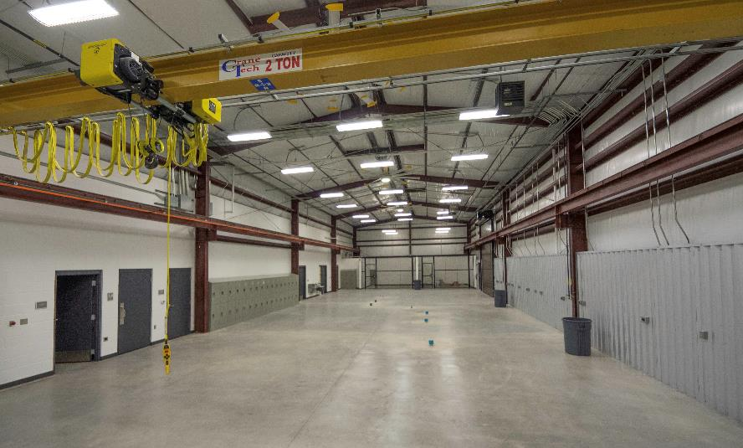
THE OPPORTUNITY
CTE FACILITY
IRION COUNTY I.S.D.

Slide 44
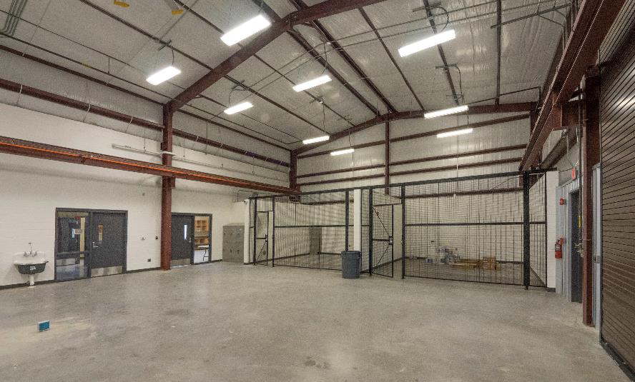
THE OPPORTUNITY
CTE FACILITY
IRION COUNTY I.S.D.

Slide 45

THE OPPORTUNITY
CTE FACILITY
IRION COUNTY I.S.D.

Slide 46

THE OPPORTUNITY
CTE FACILITY
IRION COUNTY I.S.D.

Slide 47

THE OPPORTUNITY
TENNIS COURTS
IRION COUNTY I.S.D.

Slide 48

THE OPPORTUNITY
TENNIS COURTS
IRION COUNTY I.S.D.

Slide 49
THE IMPACT

Slide 50

THE IMPACT
$ 16 Million Bond
approximately
80%
of new construction will be paid
for by wind and solar.

Slide 51



Water Valley ISD

Slide 52



Slide 54


How do Taxable Values Work?

Slide 55
2018-2019 Area Tax Rates
District | Tax Rate
Blackwell | 1.14
Roscoe | 1.40
Sterling City | 1.21
Westbrook | 1.04
Robert Lee | 1.46
Irion Co | 1.20
Water Valley | 1.32
The Water Valley ISD tax rate is similar to other districts in the area. Some neighboring districts have made use of their bond capacity and others have not yet had the chance. As discussed, Water Valley ISD has the chance to pursue a bond without any increase to the overall Tax Rate of the School District…

Slide 56

Tax Impact & Bond Capacity
 | Homestead Tax Impact
Taxable Home Value | $25,000 | $50,000 | $75,000 | $100,000
Yearly Tax Effect | $0 | $0 | $0 | $0
Monthly | 0 | $0 | $0 | $0
As Taxable Values increase due to the addition of wind and solar energy, it will enable Water Valley ISD to take on a new bond project without increasing the overall tax rate for the school. In 2018-2019 the district set a rate of $1.32/100 and they’ve set the same $1.32 rate in 2019-2020. A passed bond election will not cause an increase in the School Districts tax rate.

Slide 57
DISCLAIMER
Per MSRB Rule G-17 and the SEC Municipal Advisor Rule, Live Oak Public Finance, LLC (“the Firm”), is not recommending an action to you as the municipal entity or obligated person. The information provided is not intended to be and should not be construed as “advice” within the meaning of Section 15B of the Securities Exchange Act of 1934. This information is being provided for discussion purposes, and you should discuss any information and material contained in this communication with any and all internal or external advisors and experts that you deem appropriate before acting on this information or material.
Unless otherwise agreed, the Firm is not acting as a municipal advisor to you and does not owe a fiduciary duty pursuant to Section 15B of the Exchange Act to you with respect to the information and material contained in this communication. The accompanying information was obtained from sources which the Firm believes to be reliable but does not guarantee its accuracy and completeness.
The material has been prepared solely for informational purposes and is not a solicitation of an offer to buy or sell any security or instrument or to participate in any trading strategy. Historical data is not an indication of future results. The opinions expressed are our own unless otherwise stated.
Additional information is available upon request.

Slide 58

www.liveoakpf.com
(512) 726-5547
info@liveoakpf.com

Slide 59

THE IMPACT
$ 16 Million Bond
there is absolutely
for those who…
NO TAX INCREASE
are over 65 years of age AND
have filed their Homestead Exemption Act
Unless Improvements are made since filing for the Homestead Exemption

Slide 60

VOTE
TUESDAY
NOV. 5TH
[ early voting begins OCT. 21ST ]
COKE COUNTY
TOM GREEN COUNTY
WHEN?
Oct. 21st – Nov. 1st
8 AM – 5 PM (Mon. – Thurs.)
8 AM – 1 PM (Friday)
WHEN?
Oct. 21st – Nov. 1st
8 AM – 5 PM (Oct. 21 - 30)
7 AM – 7 PM (Oct. 31 - Nov. 1)
WHERE?
Coke County Courthouse
13 E. 7th Street
Robert Lee, Texas 76945
WHERE?
Edd B. & Frances Frink Keys
Building - 1st Floor
113 W. Beauregard Ave.
San Angelo, Texas 76903

Slide 61

VOTE
TUESDAY
NOV. 5TH
[ early voting begins OCT. 21ST ]

